Slide 1
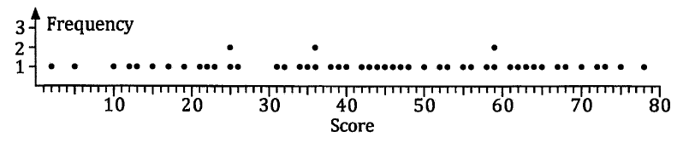
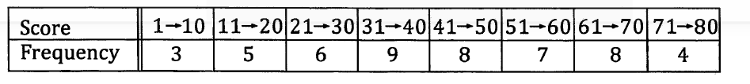
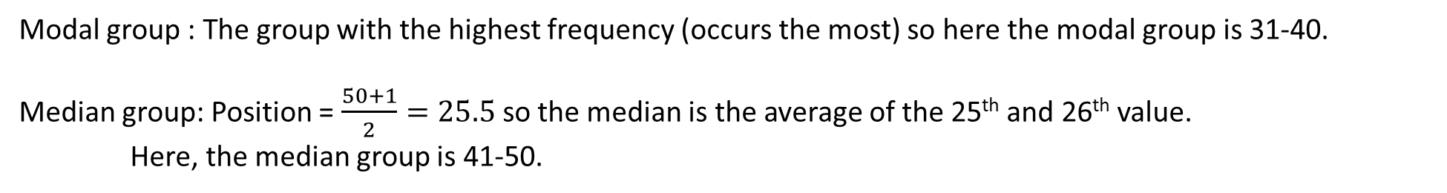
Averages from Grouped Data
This discrete data set is very spread out. Sometimes it is better to group discrete or continuous data.
If we group the discrete values in groups of 10, we create a table of values that is a lot easier to work with.
We can find out the modal class/group or the median class/group similarly to how we would if the frequency table wasn’t grouped.
Modal group : The group with the highest frequency (occurs the most) so here the modal group is 31-40.
Median group: Position = $\frac{50+1}{2}=25.5$so the median is the average of the 25th and 26th value.
Here, the median group is 41-50.

Slide 2
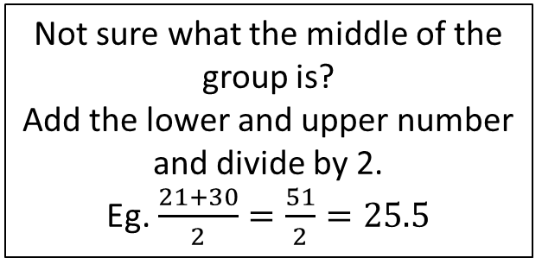
Averages from Grouped Data
Not sure what the middle of the group is?
Add the lower and upper number and divide by 2.
Eg. $\frac{21+30}{2}=\frac{51}{2}=25.5$
Finding the mean of grouped data is a little bit trickier as we don’t necessarily know where each data value lies within the group.
We have to calculate the estimate of the mean by assuming every data value lies right in the middle of each group. So we assume the first 3 data values were 5.5, the next 5 were 15.5, the next 6 were 25.5 and so on.
Estimated Mean: $\frac{3×5.5+5×15.5+6×25.5+9×35.5+8×45.5+7×55.5+8×65.5+4×75.5}{50}= \frac{2145}{50}=42.9$

Slide 3
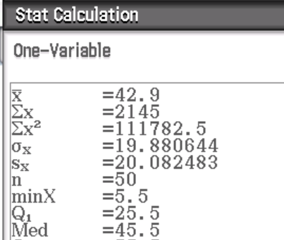
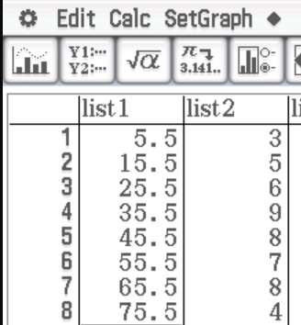
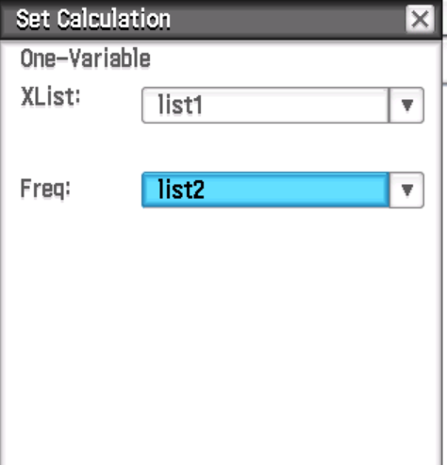
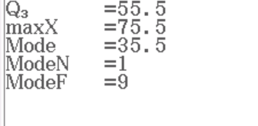
Averages from Grouped Data
Now do Exercise 2B
We can still get these answers by using our ClassPad and remembering what assumptions we have made.
The estimated mean is 42.9.
The estimated median is 45.5 so we give the group 41-50.
The estimated mode is 35.5 so we give the group 31-40.

